Slide 1


Jerry Osorio
June 10, 2021

Slide 2
Load Testing Using K6
June 10, 2021

Slide 3

Why load testing?

Slide 4
Non-functional characteristics
Performance efficiency
Compatibility
Usability
Reliability
Security
Maintainability
Source: Acceptance testing specialist syllabus

Slide 5
Non-functional characteristics
Performance efficiency
Compatibility
Usability
Reliability
Security
Maintainability
Source: Acceptance testing specialist syllabus

Slide 6

What is performance efficiency?
Performance efficiency (or simply “performance”) is an essential part of providing a “good experience” for users when they use their applications on a variety of fixed and mobile platforms

Slide 7

What is performance testing?
Performance testing is an umbrella term including any kind of testing focused on performance of the system or component under different volumes of load.

Slide 8

Types of performance testing

Slide 9
Load Testing
Virtual users
Realistic Loads
Timeline (1 hr)
MAX VU = 10

Slide 10
Stress Testing
Virtual users
Realistic Loads
Timeline
MAX VU = 10, Check the system does not crash

Slide 11
Scalability Testing
Focuses on the ability of a system to meet future efficiency requirements which may be beyond those currently required
Instead support 10 VU as realistic load now we want to support 20 VU

Slide 12
Spike Testing
Virtual users
Realistic Loads
Timeline
Ability of a system to recover from sudden bursts of peak loads and return to steady state

Slide 13


Spike Testing Example
Photo Source: Macdonalds Official Page
Photo Source: Uber Official Page

Slide 14
Endurance (Soak) Testing
Virtual users
Realistic Loads
Timeline (10 hr)
MAX VU = 10

Slide 15
Concurrency Testing
Virtual users
Realistic Loads
Timeline

Slide 16

Concurrency Testing (Example)
Case of Study: Metallica’s Concert, Guatemala 2010
Photo Source: Metallica Official Page

Slide 17
Capacity Testing
Determined how many users or transaction a given system will support and still meet the performance objectives

Slide 18
Let's get started

Slide 19

What is K6?
Load testing cloud tool

Slide 20



Installing
Linux -> Ubuntu repository
Mac -> Using homebrew
Windows -> Binaries or docker image

Slide 21
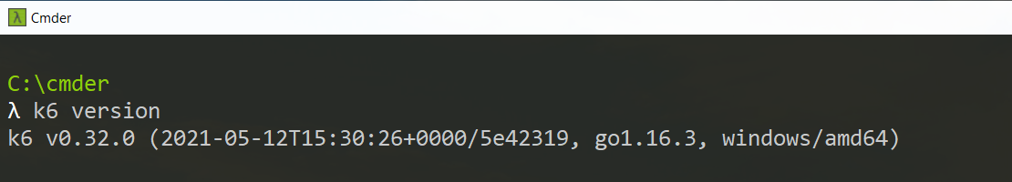
Check k6 version

Slide 22
Running test in K6
Local: In your local machine
Cloud: On cloud infrastructure managed by K6 Cloud
Clustered: on more than one machine managed by you (Not supported yet)

Slide 23
Example Running Local

Slide 24
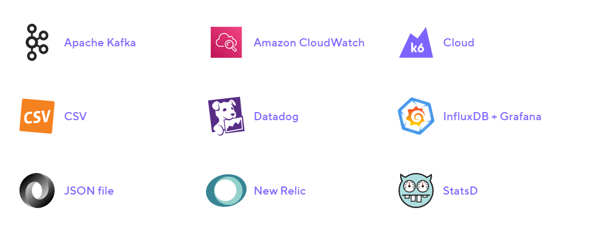
Sending Metrics

Slide 25
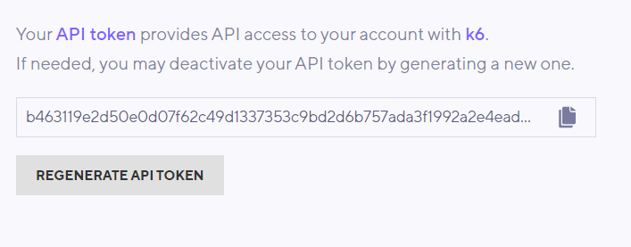
Running Local and sending metrics to K6
Api Token

Slide 26
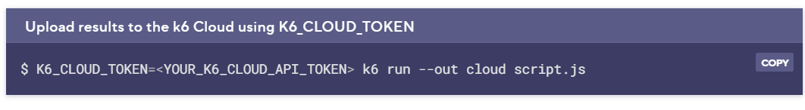
Running Local and sending metrics to K6
Execute test and send metrics

Slide 27
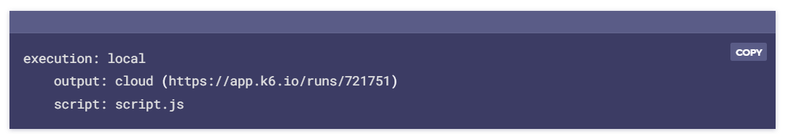
Running Local and sending metrics to K6
View Metrics

Slide 28
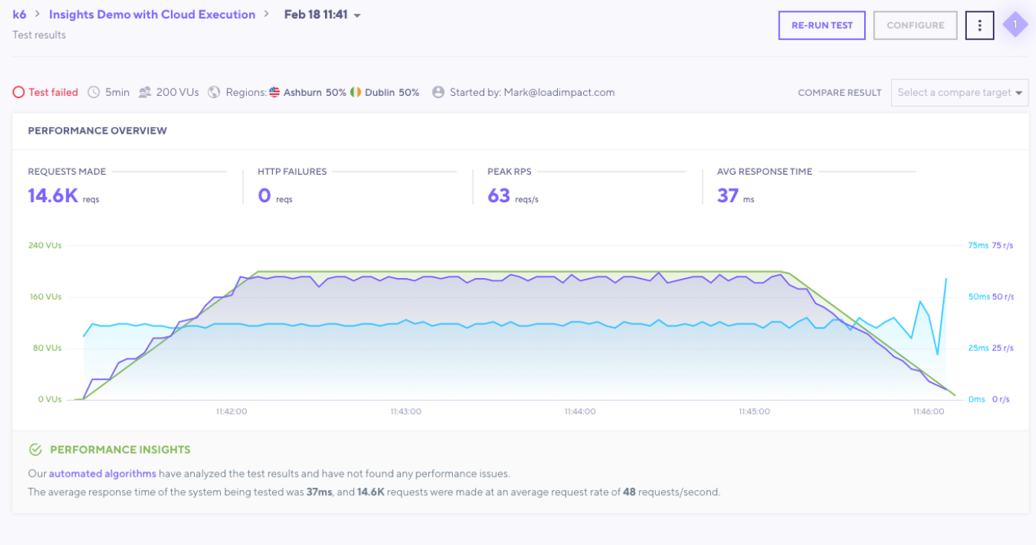
Running Local and sending metrics to K6
View Metrics

Slide 29
K6 Live Demos

